Slide 3
Modulo-2
Digital coding uses modulo-2 arithmetic where addition becomes the following operations:
0+0=0 1+1=0
0+1=1 1+0=1
It performs the equivalent operation to an exclusive-OR (XOR) function. For modulo-2 arithmetic, subtraction is the same operation as addition:
0–0=0 1–1=0
0–1=1 1–0=1
Multiplication is performed with the following:
0×0=0 0×1=0
1×0=0 1×1=1
which is an equivalent operation to a logical AND operation.

Slide 4
Binary Manipulation
Link.

Slide 5
Binary Manipulation
x⁴+x⁴+x²+1+1 becomes x²
as x⁴+x⁴ =0

Slide 6
Binary Manipulation
Link.

Slide 7
Modulo-2 Division
Link.

Slide 8
Hamming distance
Hamming difference between 101101010 and 011101100? Link.
The Hamming distance can be used to determine how well the code will cope with errors. The minimum Hamming distance min{d(C₁,C₂)} defines by how many bits the code must change so that one code can become another code.
A code C can detect up to N errors for any code word if d(C) is greater than or equal to N+1 (that is, d(C)≥N+1).
A code C can correct up to M errors in any code word if d(C) is greater than or equal to 2M+1 (that is, d(C)≥2M+1).

Slide 9
Error detection
For example: {00000, 01101, 10110, 11011} has a Hamming distance of 3. Link.
d(C)≥N+1
d(C) is 3, thus N must be 2. So we can detect one or two bits in error in the code.
Eg 00000 could become 01010 ... and this will be detected as an error, as the code does not exist.

Slide 10
Error correction
For example: {00000, 01101, 10110, 11011} has a Hamming distance of 3. Link.
d(C)≥2M+1
d(C) is 3, thus M must be 1. So we can correct one bit in error in the code.
Eg 00000 could become 00010 ... and as the nearest code will be “00000”.

Slide 11
Examples
What is the Hamming distance of {00000000, 11111111, 11110000, 01010101} Link? How many errors can be detected? How many errors can be corrected?
What is the Hamming distance of {10111101011, 10011111011, 11110101011, 10100101011, 10111101000} Link?

Slide 13
Probability Theorem
If an event X has a probability of P(X) and event Y has a probability of P(Y) then the probability that either might occur is:
P(X or Y) = P(A) + P(B) – P(X and Y)
If one event prevents the other from happening, then they are mutually exclusive, thus P(X and Y) will be zero. This will give:
P(X or Y) = P(X) + P(Y)

Slide 14
Probability Theorem
If an event X has a probability of P(X) and event Y has a probability of P(Y) then the probability that both might occur is:
P(X and Y)=P(X)×P(Y | X)
P(X and Y)=P(Y)×P(X | Y)
P(Y | X) is the probability that event Y will occur, assuming X has already occurred. If the two events are independent then P(X | Y) will be P(X) and P(Y | X) will be P(Y):
P(X and Y)=P(X)×P(Y)

Slide 15
Error probability
n bits
transmitted

Slide 16
Error probability
The probability of a single error can be determined by assuming that all the other bits are received correctly, thus this will be:
p(1-p)^{n–1}
As there are n bit positions then the probability of a single bit error will be:
Probability of single error = n.p(1-p)^{n–1}
For example if the received data has 256 bits and the probability of an error in a single bit is 0.001 then:
Probability of no error = (1-0.001)²⁵⁶ = 0.774
Probability of error = 1-0.774 = 0.0062
Probability of single error=8×0.001(1-0.001)^{256–1} = 0.1984

Slide 18
Linear and cyclic codes
Linear Code: sum of any two codes equals another code - {00, 01, 10, 11} and {00000, 01101, 10110, 11011}.
Cyclic Codes: Linear Code + When a cyclic shift also gives a code word - {0000, 0110, 0011, 1001, 1100, 0001, 0010, 0100, 1000}
Is {000, 010, 011, 100, 001} cyclic?

Slide 19
Block parity
Odd parity (make number of 1s odd) or Even parity (make number of 1s even).
Detects single bit errors.
Cannot detect when two bits in error in the same position.
Example (binary). Link.
Example (int). Link.

Slide 21
Cyclic redundancy checking (CRC)
Example: We have 32, and make it divisible by 9, we add a ‘0’ to make ‘320’, and now divide by 9, to give 35 remainder 4. So lets add ‘4’ to make 324. Now when it is received we divide by 9, and if the answer is zero, there are no errors, and we can ignore the last digit.
The error correction code is 16 bits long and is the remainder of the data message polynomial G(x) divided by the generator polynomial P(x) (x¹⁶+x¹²+x⁵+1, i.e. 10001000000100001).
The quotient is discarded and the remainder is truncated to 16 bits. This is then appended to the message as the coded word.
CRC-CCITT: x¹⁶+x¹²+x⁵+1
x¹⁶+x¹²+x⁵+1 G(x)

Slide 22
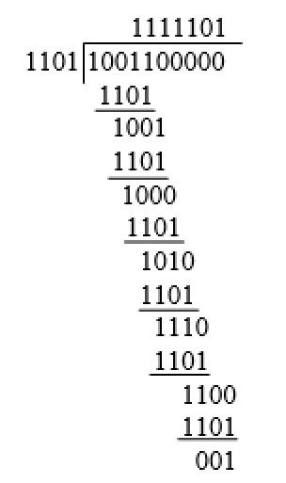
CRC Example
Example. Link.
Figure 5.3

Slide 23
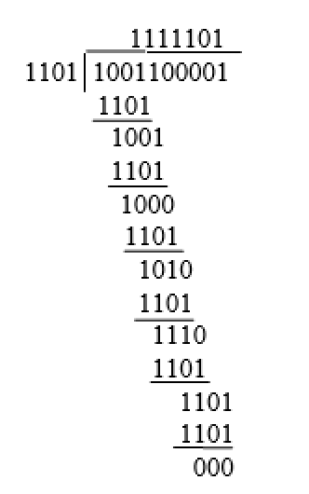
CRC (Receiving)
Example. Link.
No error!

Slide 24
LRC/VRC
Link.

Slide 26
Hamming Codes
Error correction: m is number of bits in the data symbol
n is number of Hamming bits
Eg if we have 4 bits (m=4). Then to correct we need n=3 (as 8 is greater than or equal to 4+3+1).
How many error correcting bits would be need for 5 bits?

Slide 27
Hamming Codes

Slide 28
Hamming Codes
No error
Error in bit 5

Slide 29
Hamming Code
Sending:
Receiving:

Slide 30

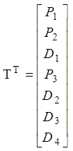
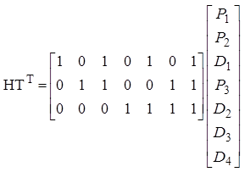
Hamming Code

Slide 31
Hamming Code (receiving)
At the receiver we calculate the Syndrome matrix S ... if all zeros ... no error!

Slide 32
Hamming Code (Example)
Link.

Slide 33
Hamming Code
Let’s check the Syndrome matrix:
No error!

Slide 34
Hamming Code
Error in bit 5
Error:

