Slide 3
JPEG Process

Slide 4
RGB to YC_{b}C_{r}
Y strongly dependent on Green component
Y=0.299R+0.587G+0.114B
C_{b}=0.1687R–0.3313G+0.5B
C_{r}=0.5R–0.4187G+0.0813B
C_{b} strongly dependent on Blue component
C_{r} strongly dependent on Blue component

Slide 5
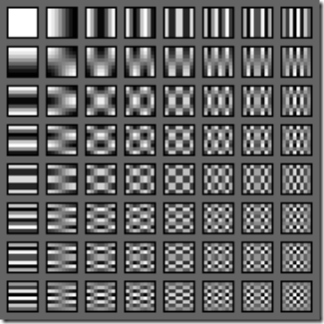
Discrete Cosine Transform (DCT)
Link

Slide 6
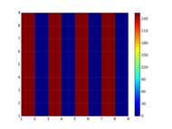
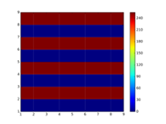
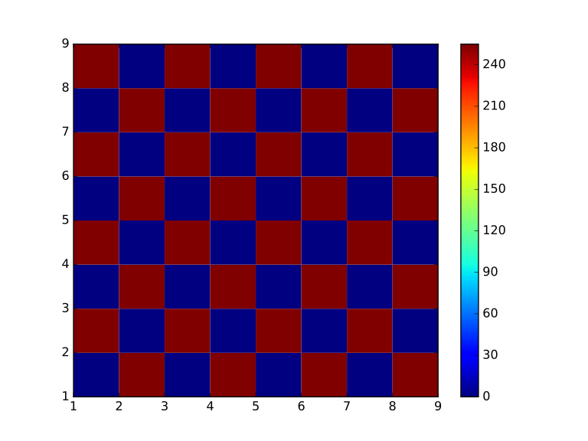
DCT
[[1020 183 0 216 0 324 0 924]
[ 0 0 0 0 0 0 0 0]
[ 0 0 0 0 0 0 0 0]
[ 0 0 0 0 0 0 0 0]
[ 0 0 0 0 0 0 0 0]
[ 0 0 0 0 0 0 0 0]
[ 0 0 0 0 0 0 0 0]
[ 0 0 0 0 0 0 0 0]]
[[1020 0 0 0 0 0 0 0]
[ 0 -33 0 -39 0 -58 0 -166]
[ 0 0 0 0 0 0 0 0]
[ 0 -39 0 -46 0 -69 0 -196]
[ 0 0 0 0 0 0 0 0]
[ 0 -58 0 -69 0 -103 0 -294]
[ 0 0 0 0 0 0 0 0]
[ 0 -166 0 -196 0 -294 0 -837]]
[[1020 0 0 0 0 0 0 0]
[-183 0 0 0 0 0 0 0]
[ 0 0 0 0 0 0 0 0]
[-216 0 0 0 0 0 0 0]
[ 0 0 0 0 0 0 0 0]
[-324 0 0 0 0 0 0 0]
[ 0 0 0 0 0 0 0 0]
[-924 0 0 0 0 0 0 0]]
Link

Slide 7
Quantisation
The quantisation part aims to suppress less important special frequencies to zero, while preserving important ones.

Slide 8


Quantisation
Link
Quantisation of 16.
Quantisation of 256.

Slide 9


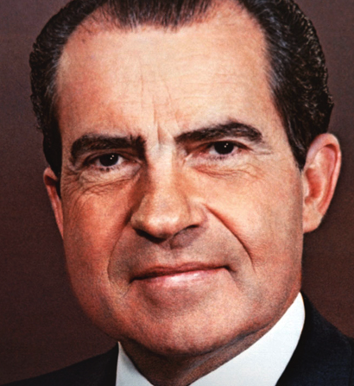
Quantisation
Eye is less sensitive to fast changes of colour.
Eye more sensitive to changes in luminosity (Y).

Slide 10
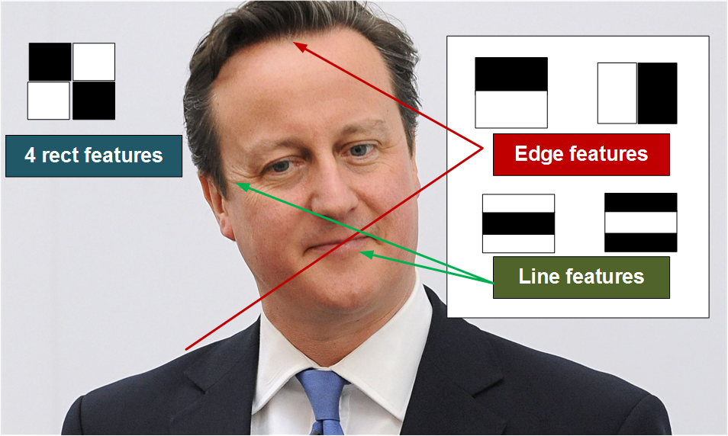
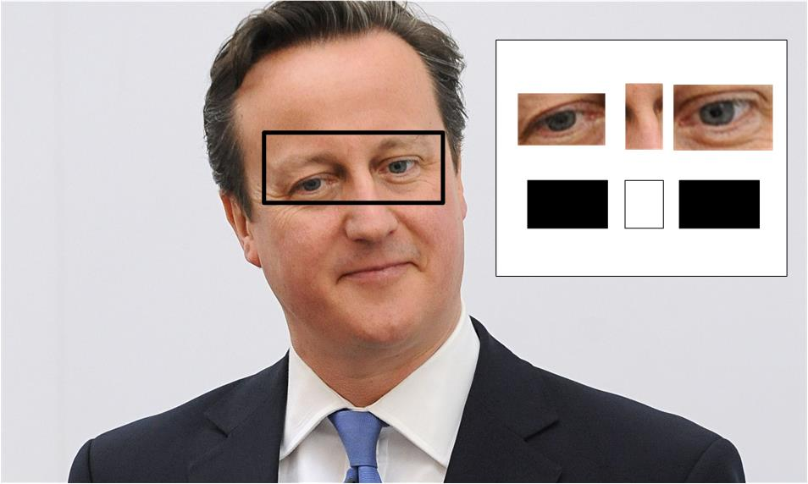
Face Detection
Link

Slide 11
Zig-zag storage and VLC
251 0 -2 -1 0 0 0 0
-5 -3 0 0 0 0 0 0
-1 -1 0 0 0 0 0 0
0 0 0 0 0 0 0 0
0 0 0 0 0 0 0 0
0 0 0 0 0 0 0 0
0 0 0 0 0 0 0 0
0 0 0 0 0 0 0 0
251, 0, -5, -1, -3, -2, 0, -1, 0, 0, 0, 0, -1, 0, 0, 0, 0,…,0
-> 251, 0, -5, -1, -3, -2, 0, -1 ...[51 zeros]

Slide 13
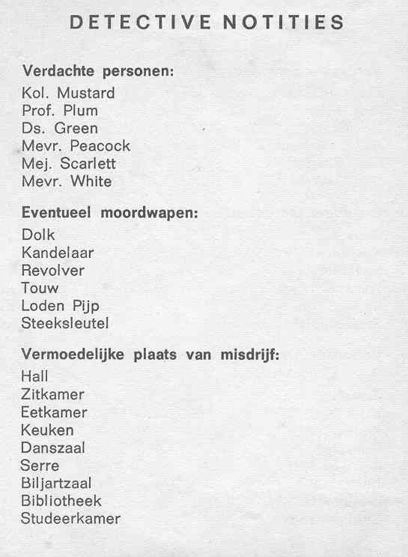
JPEG Tags
[00000000] FF D8 FF E0 00 10 4A 46 49 46 00 01 00 01 00 C8 ......JFIF......
[00000016] 00 C8 00 00 FF FE 00 1F 4C 45 41 44 20 54 65 63 ........LEAD.Tec
[00000032] 68 6E 6F 6C 6F 67 69 65 73 20 49 6E 63 2E 20 56 hnologies.Inc..V
[00000048] 31 2E 30 31 00 FF DB 00 43 00 19 11 12 16 12 0F 1.01....C.......
[00000064] 19 16 14 16 1C 1A 19 1E 25 3F 29 25 22 22 25 4D ........%?)%""%M
[00000080] 37 3A 2D 3F 5B 50 60 5E 5A 50 58 56 65 71 91 7B 7:-?[P`^ZPXVeq.{
[00000096] 65 6B 89 6D 56 58 7E AC 7F 89 96 9A A2 A4 A2 61 ek.mVX~........a
Link
Link
FF F8 tag – Start of file
FF DB tag (Quantization Table).
FF C4 tag (Huffman Table).
FF C0 tag (Start Of Frame (Baseline DCT)).
FF DA tag (Start Of Scan).
FF 00 stuffed FF (Likely Huffman Coding).

