Slide 1
Within three years will health records be on-line?
Yes.
No
Don’t know

Slide 2
Which service would you most like to get access to?
View health record.
Book appointments.
Email with clinical staff.
Video conference with clinical staff.
Order repeat prescriptions.
Manage my child’s health record.

Slide 3
If you had access, what would you like to do with your data?
Check its accuracy
Recall key information
Make amendments
Add comments

Slide 4
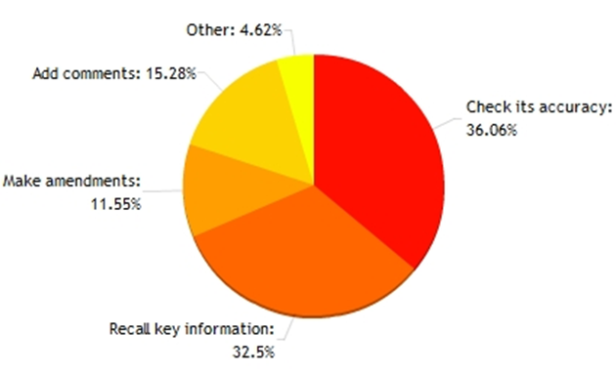
What would you want to do with the data?
Review lab results and medication
research treatments and developments
Ascertain what actions to take in life.
Order repeat prescriptions
Review doctors opinions on myself
Understand what's on file
Track my progress/history
Have access in order if laboratory results (others) need to be provided to private clinic or foreign GP.
Use it to monitor and manage my health issues
Be able to access e.g. inoculation records
Add content/use it in consultations
Challenge assumptions - quality of NHS doctor has gone down dramatically.
Make complaints about doctors based on comments
Use to inform health choices
Request deletion irrelevant information
Check who has accessed my records and demand explanations where appropriate
Print off my repeat prescription
See who has accessed it (including LEA etc) at all times
Learn more about myself in relation to ill health
Use for health and travel insurance (and other things where I need to demonstrate/recall information about my health)
Give to other HCP who don't have access.
Notes:
Recall name of medicines, to enable repeat prescription
Have sensitive info removed or excluded from o/l version
Request amendments and update eg diet/meds
Use it to inform discussions with locums etc.
Learn
Check who has had access to it and when.
To monitor current health status against documented status, so i can made my own adjustments to lifestyle, and make decisions about when I GP appointment might be required
would like to check any blood test results and various other results for myself and be able to see the data instead of people saying everything as being 'normal' i like to how the measures.
Ask questions.
Check up on results and just have an overall outlook on my health
To see medical comments and information / comments that are not normally relayed to patients
Follow up appointments, and conditions with specialists.
Communicate with contributors to the record
More active role in health management
Transfer to a personal health record
Fold in personally-collected data to help define personal baseline of 'wellness', against which 'illness' can be assessed.

Slide 5
Who should own the data?
Your GP
I should own the data
Hospital
Government

Slide 6
Greatest barrier to Citizen Access
Poor security within the health care system.
Resistance from health and social care professional
Lack of understanding of the usage of the Internet from citizens.
Difficult to change existing systems to allow access
Poor access to the Internet.
Cost of building an IT system to provide access.

Slide 7
To access your health record, which of the following would you most trust to provide your identity?
Facebook
Microsoft Live
LinkedIn
Twitter
Google
Apple
UK/Scottish Government
Your bank card security procedure.
A new security tool you control.

Slide 8
To access your health record, which of the following would you least trust to provide your identity?
A new security tool you control
Apple
Facebook
Google
LinkedIn
Microsoft
My Doctors Control
Twitter
UK/Scottish Government

